Slide 1
Foot and Mouth Disease
The Impact on Livestock, Livelihoods, Trade and Opportunities for Conservation
Dr. Carolyn C. Benigno
Animal Health Officer
U.N. FAO Regional Office for Asia and the Pacific
Dr. Ronello C. Abila
OIE RCU Coordinator
SEAFMD Campaign

Slide 2
Presentation
FAO –OIE GF-TADS
SEAFMD Model
FMD the disease and situation
Impact of FMD (from two case studies)

Slide 3
FAO - Mission and Priorities
Encouragement of sustainable agriculture and rural development
Long term strategy to increase food production and food security while conserving and managing natural resources
Provide a neutral forum where all nations can discuss and formulate policy on major food and agriculture issues

Slide 4
FAO’s Strategic Framework recalled in the FAO Medium Term Plan 2004-2009
Contribution to the eradication of food insecurity and rural poverty;
Promotion, development and reinforcing policy and regulatory frameworks for food, agriculture, fisheries and forestry;
Creating sustainable increases in the supply and availability of food and other products from the crop, livestock, fisheries and forestry sectors;
Supporting the conservation, improvement and sustainable use of natural resources for food and agriculture; and
Improving decision making through the provision of information and assessments and fostering of knowledge management for food and agriculture.

Slide 5



Global Framework for the Progressive Control of Foot-and-Mouth Disease and Other Transboundary Animal Diseases

Slide 6
GOAL of GF-TADs = Vision
Development Objective
To improve the protein food security and incomes of developing countries
Safeguard the world livestock industry (of developed as well as developing countries) from repeat shocks of infectious disease epidemics
Promoting safe and globalised trade in livestock and animal products

Slide 7
CONCEPT
Progressive control of transboundary animal diseases
AT SOURCE
as
an International Public Good and within the Millennium Goals.

Slide 8
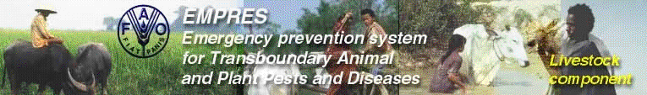

What are we aiming for ?
A strong and working close partnership with Countries and Regional Organizations
Strengthening Veterinary Services
Paradigm shift in disease control by sound epidemiological knowledge
Progressive control of disease

Slide 9
Programme Thrusts
Global Strategy driven by the FMD Model
Global Strategy taking lessons from the GREP experience
Regional strategies owned and implemented by regional organisations and Countries

Slide 10
SEAFMD Model

Slide 11
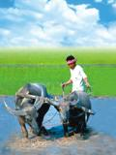
SEAFMD Campaign
Office International des Epizootes (OIE) Southeast Asia Foot and Mouth Disease (SEAFMD) Campaign

Slide 12
SEAFMD Campaign
1994 - OIE Sub-Commission for FMD Control in Southeast Asia
1995 - 1st Meeting
1997 - OIE Regional Coordinating Unit (RCU) for SEAFMD was established in Bangkok

Slide 13
OIE SEAFMD Campaign
Phase I (1997 to 2000)
Funding from Switzerland, Australia, OIE Tokyo,
Support from Thailand and member countries (in Kind)

Slide 14
OIE SEAFMD Campaign
Phase II (2001 to 2004)
Funding mainly from Australia
Support from OIE Tokyo and in kind contribution from Thailand and member countries

Slide 15
OIE SEAFMD Campaign
Goal
  to increase food security and alleviate poverty amongst the rural small holder producers of livestock.
Purpose
  to increase the productivity and economic output of the livestock sector by controlling and eradicating FMD.
Objective
  to add value to the regional control program through SEAFMDC by employing a series of integrated and harmonised approaches to disease control

Slide 16
Components of SEAFMD
International Coordination and Support
Program management, resources and funding
Public Awareness and Communication
Disease surveillance, diagnosis, reporting and control
Policy, legislation and standards to support disease control and zone establishment
Regional research and technology transfer
Livestock sector development including private sector integration
Monitoring and evaluation

Slide 17
FMD, the disease and situation

Slide 18
Foot and Mouth Disease
caused by a virus of the genus Aphthovirus, family Picornaviridae.
seven serotypes of FMD virus
O, A, C, SAT 1, SAT 2, SAT 3, and Asia 1,
Disease of cloven-footed animals
No public health importance

Slide 19
Species affected
Domestic animals - Cattle, pigs, sheep, goats and buffalo
many species of cloven-hoofed wildlife, such as African buffalo, deer, antelope and wild pigs may become infected
apart from the African buffalo wildlife involvement in the epidemiology of FMD in the domesticated species is not certain
strains of FMD virus that infect cattle have been isolated from wild pigs and deer

Slide 20
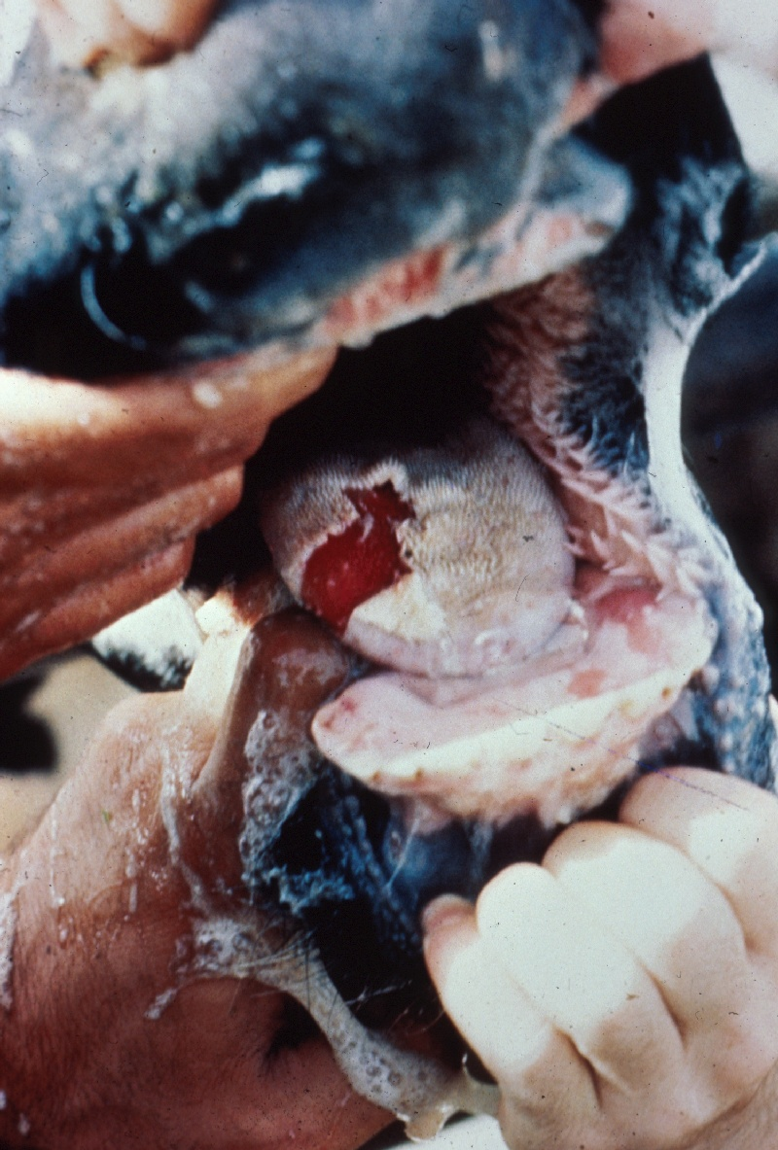
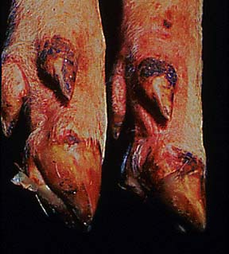
Clinical signs
Vesicular diseases
vesicles(blisters) and erosions of the epithelium of the mouth, nares, muzzle, feet, and teats
fever, lameness, inappetence
Highly contagious
High Morbidity, low mortality

Slide 21
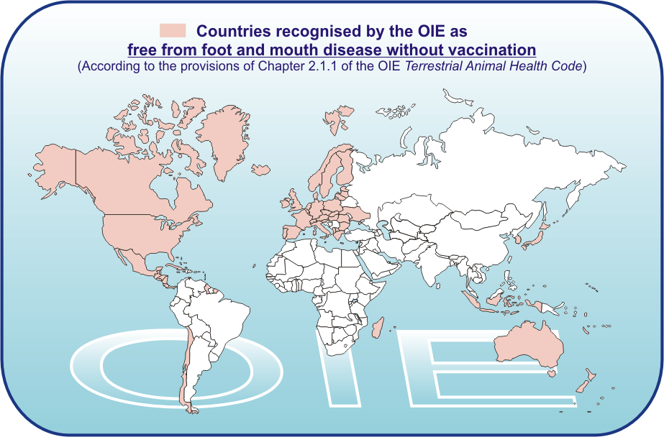
OIE Website - January 2004

Slide 22
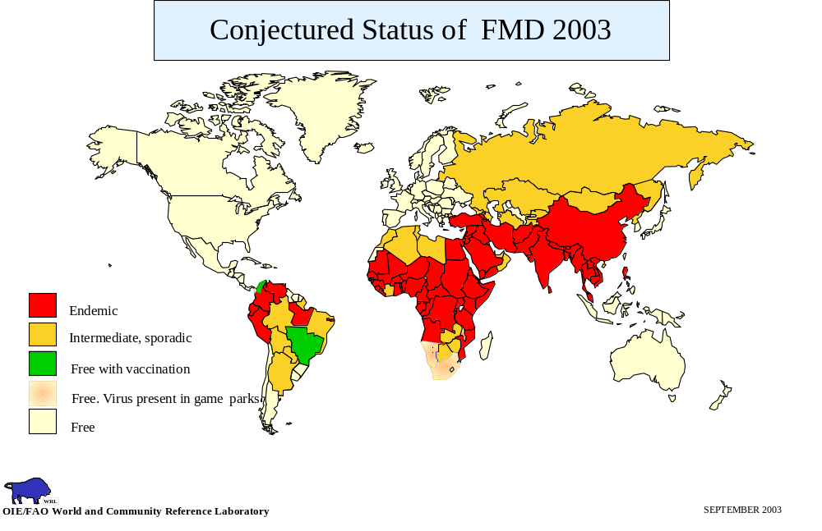

Slide 23
Countries in which FMD was reported, 2003
43 countries reported FMDV outbreaks
Cambodia (?)
Hong Kong (O)
Laos PDR (O)
Malaysia (A&O)
Myanmar (O)
Philippines (O)
Thailand (A&O)
Vietnam (O)
Argentina
Bolivia
Ecuador
Paraguay
Venezuela
Afghanistan
Bangladesh
Bhutan
India
Iran
Nepal
Pakistan
Tajikistan
Turkey
UEA
Benin, Botswana, Burkina Faso,
Burundi, Chad, Eritrea, Ethiopia, Ghana, Kenya, Libya, Malawi, Mali, Mozambique, Niger, Nigeria, South Africa, Tanzania, Togo, Uganda, Zimbabwe
WRL
OIE/FAO World and Community Reference Laboratory
10 FEBRUARY 2004

Slide 24
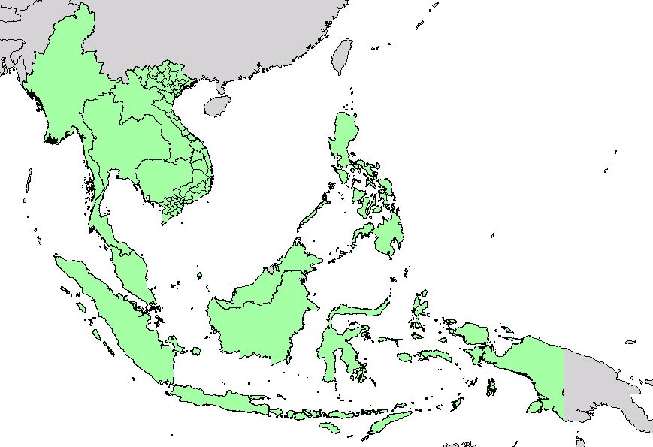
Southeast Asia FMD Campaign
8 countries

Slide 25
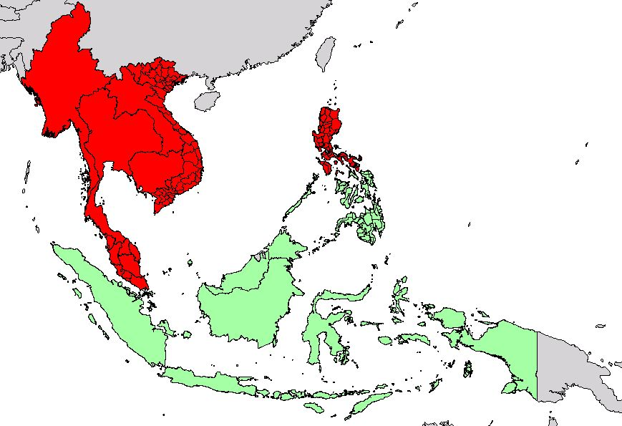
Southeast Asia FMD Status
OIE FMD Free Zone
FMD Infected Areas

Slide 26
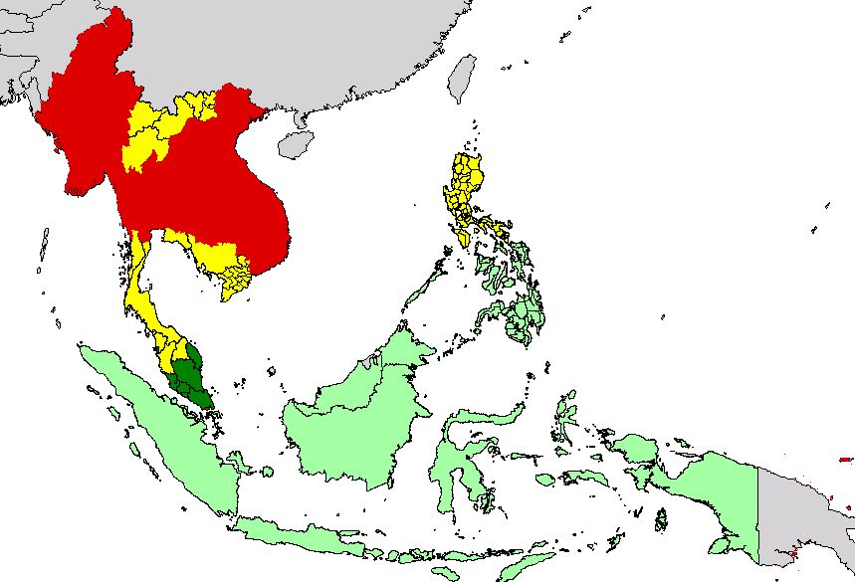
Southeast Asia FMD Progressive Zoning
Infected Areas
Progressive Zoning
OIE FMD Free zone

Slide 27
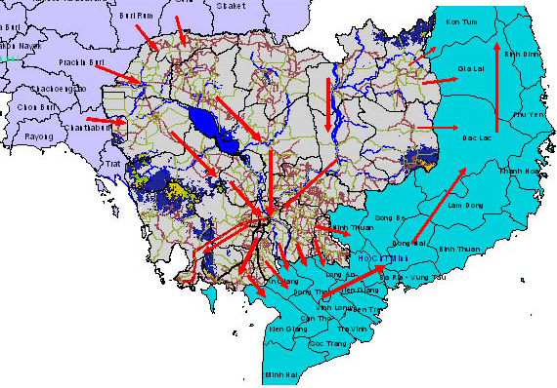
Cattle Movement 2004

Slide 28
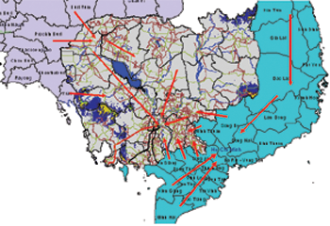
Pig Movement 2004

Slide 29
Impact of FMD

Slide 30
Overview of the Regional Impacts of FMD and Control
Massive expenditures by the government sector on FMD control
Productivity losses in more developed livestock industries ie pig and beef industries of the Philippines and Malaysia and dairy industry of Thailand
Heavy losses in small scale mixed farming when outbreaks occur in buffalo during the planting season – Myanmar, Lao, Cambodia, Vietnam
High costs of vaccination borne by the commercial pig producer
Considerable losses of milk yield
“The economic impact of FMD and its control in SEA: a preliminary assessment with special reference to Thailand” B.D. Perry, W. Kalpravidh, G.G. Coleman, H.S.Horst, J.J.McDermott, T.F.Randolph and L.F. Gleeson

Slide 31

Impact on Farmer’s livelihood
Loss draught power – Myanmar, Cambodia, Indonesia, Lao, Vietnam
Low productivity
Added cost on treatment
Reduced value of their livestock
Reduced farmer’s income

Slide 32
Philippines Case Study
The economic impact of FMD control and eradication in the Philippines
Randolph, Perry, Benigno, Santos, Agbayani, Coleman Webb, Gleeson
1997 annual economic impact of FMD – USD14 M
Baseline scenario (from historical trends) :
  USD 1.1 M government costs on surviellance an d monitoring activities
  USD0.3 M to contain persistent outbreaks
  USD1.7 M commercial support for vaccination
Eradication Scenarios
  Cost of FMD increases
  Once eradicated, private and government sectors no longer incur control costs
  Total costs at USD 2.4 M constant per year for emergency preparedness

Slide 33
Benefits associated with FMD eradication
Reduction of the control costs
Containment costs eliminated
Improved productivity at farm level
Eliminate direct impact of outbreaks on markets for livestock and meat products
Access to new export markets
Generation of additional foreign currency
Improvement of control of other livestock diseases
Protection of the susceptible wildlife population
  Tamaraws (Bubalus mindorensis), wild pigs, deer

Slide 34
Wildlife Population in the Philippines
Tamaraw, wild boars and deer
Located in FMD free areas
2002, FMD outbreak in pigs in an island province where there is a tamaraw conservation area
  Immediate stamping out of the pigs
  To preserve its FMD free status
  Disastrous if FMD hits the susceptible wildlife population

Slide 35
Challenges
Key epidemiological aspects to be noted
  Where is the disease -Disease at the SOURCE
  Infection at the source
  Hunting for the antigen rather than following the antibody
  Epidemiology~Laboratory Networks
  Knowledge on animal production, susceptible population, land usage, marketing schemes, movement patterns …

Slide 36
Challenges
Socio-political Issues
  Political Will and Grass Roots initiatives?!
  Limited investment from the Private Sector / Mobilisation of resources …
  Collaboration with disease control partners
  Weak recognition of the importance of livestock sector

Slide 37

thank you

